Slide 1
Energy Management & Audit
Lecture 1
By
Dr. Sayyad Naimuddin

Slide 2
ENERGY SCENARIO
1.1 Introduction
Energy is one of the major inputs for the economic development of any country. In the case of the developing countries, the energy sector assumes a critical importance in view of the ever increasing energy needs requiring huge investments to meet them. Energy can be classified into several types based on the following criteria:
• Primary and Secondary energy
• Commercial and Non commercial energy
• Renewable and Non-Renewable energy

Slide 3
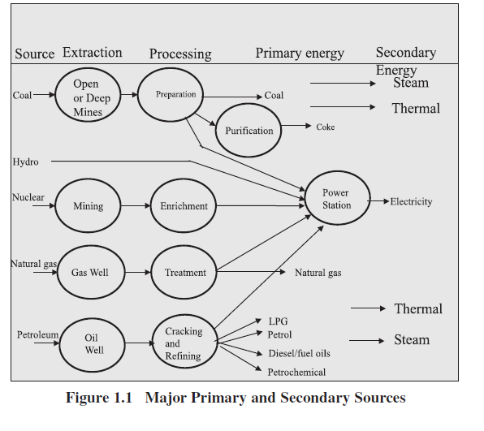
1.2 Primary and Secondary Energy

Slide 4
1.3 Commercial Energy and Non Commercial Energy
Commercial Energy
The energy sources that are available in the market for a definite price are known as commercial energy. By far the most important forms of commercial energy are electricity, coal and refined petroleum products. Commercial energy forms the basis of industrial, agricultural, transport and commercial development in the modern world. In the industrialized countries, commercialized fuels are predominant source not only for economic production, but also for many household tasks of general population.
Examples: Electricity, lignite, coal, oil, natural gas etc.

Slide 5
Non-Commercial Energy
The energy sources that are not available in the commercial market for a price are classified as non-commercial energy. Non-commercial energy sources include fuels such as firewood, cattle dung and agricultural wastes, which are traditionally gathered, and not bought at a price used especially in rural households. These are also called traditional fuels. Non-commercial energy is often ignored in energy accounting.
Example: Firewood, agro waste in rural areas; solar energy for water heating, electricity generation, for drying grain, fish and fruits; animal power for transport, threshing, lifting water for irrigation, crushing sugarcane; wind energy for lifting water and electricity generation

Slide 6
1.4 Renewable and Non-Renewable Energy
Renewable energy is energy obtained from sources that are essentially inexhaustible. Examples of renewable resources include wind power, solar power, geothermal energy, tidal power and hydroelectric power (See Figure 1.2). The most important feature of renewable energy is that it can be harnessed without the release of harmful pollutants.
Non-renewable energy is the conventional fossil fuels such as coal, oil and gas, which are likely to deplete with time.

Slide 7
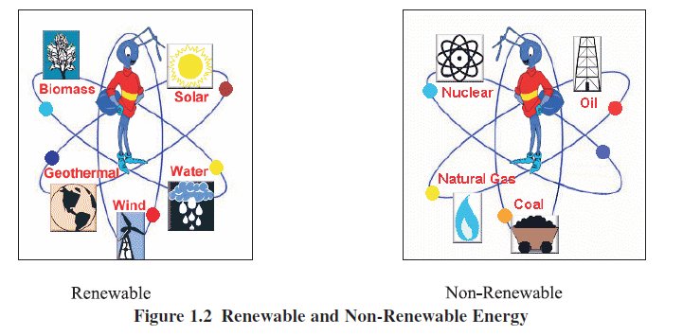

Slide 8
1.5 Global Primary Energy Reserves
Coal
The proven global coal reserve was estimated to be 9,84,453 million tonnes by end of 2003. The USA had the largest share of the global reserve (25.4%) followed by Russia (15.9%), China (11.6%). India was 4th in the list with 8.6%.

Slide 9
Oil
The global proven oil reserve was estimated to be 1147 billion barrels by the end of 2003. Saudi Arabia had the largest share of the reserve with almost 23%. (One barrel of oil is approximately 160 litres)

Slide 10
Gas
The global proven gas reserve was estimated to be 176 trillion cubic metres by the end of 2003. The Russian Federation had the largest share of the reserve with almost 27%.

Slide 11
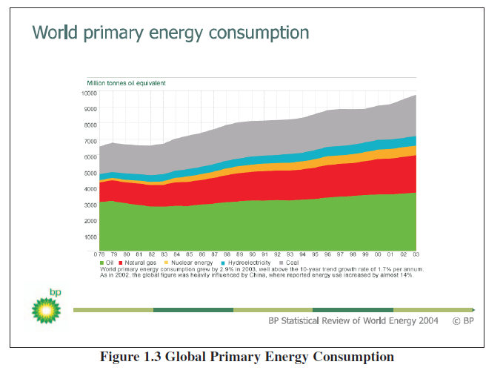
Global Primary Energy Consumption

Slide 12
The global primary energy consumption at the end of 2003 was equivalent to 9741 million tonnes of oil equivalent (Mtoe).
The Figure 1.3 shows in what proportions the sources mentioned above contributed to this global figure.

